Slide 1
Data Visualization
Patrick Mathias
Lab Medicine Core
Notes:
Hello everyone, and welcome to the third session, on Data Visualization.

Slide 2
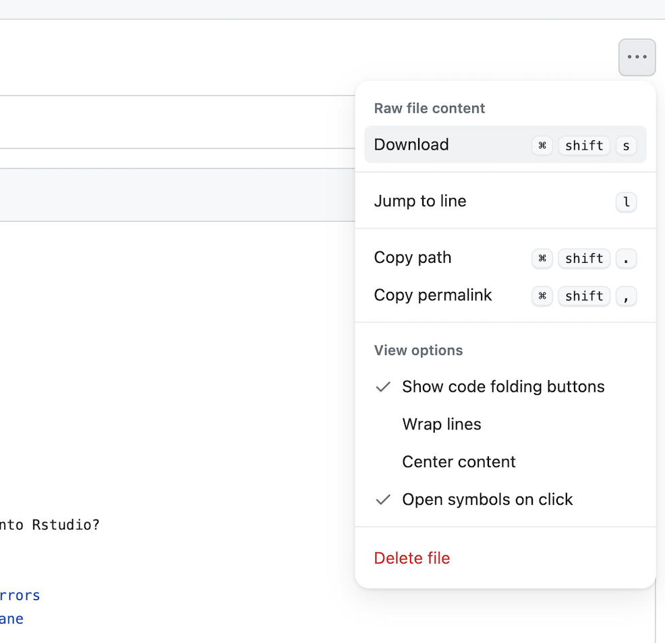
Lesson Prep
Locate the “03 – Visualize” qmd file on the course website.
Navigate to the file and use the menu on the top right to download.
Upload to your core folder on the RStudio server

Slide 3
Lesson Goals
Create basic/static visualizations that elucidate relationships within datasets (e.g., histograms, scatterplots, time series, boxplots)
Utilize programming and software tools to facilitate efficient, reproducible, and transparent data analytics workflows
Lesson Objectives
Create a basic visualization using a simple template
Define “aesthetic mapping” and explain how aesthetic mappings relate variables of a data frame to features of graphic markings on a plot
Write the code to specify a type of plot and fine tune its appearance using “geom” functions
Explain how to add layers to a ggplot object to create complex and highly customized visualizations

Slide 4
Your Turn 1
Our chemistry data set includes results for a number of analytes but we would like to focus on a subset of the data for this lesson.
Open 03 - Visualize.qmd. Execute the setup code chunk. This includes code to create a couple subsets of our chem data set for visualization. Stop when it says “Stop Here”.
Notes:
So now I’m going to ask you to imagine what the following plot would look like: …
…
Click “yes” to let me know when you have a mental picture!
Everybody have an idea? Click “yes” to let me know to go on!

Slide 5
Your Turn 2
We have created a subset of the chem data frame called k_data that only contains potassium results.
What do you think plot would look like in which:
the x-axis represents value (quantitative result)
the y-axis represents a count of observations at each value?
Notes:
So now I’m going to ask you to imagine what the following plot would look like: …
…
Click “yes” to let me know when you have a mental picture!
Everybody have an idea? Click “yes” to let me know to go on!

Slide 6
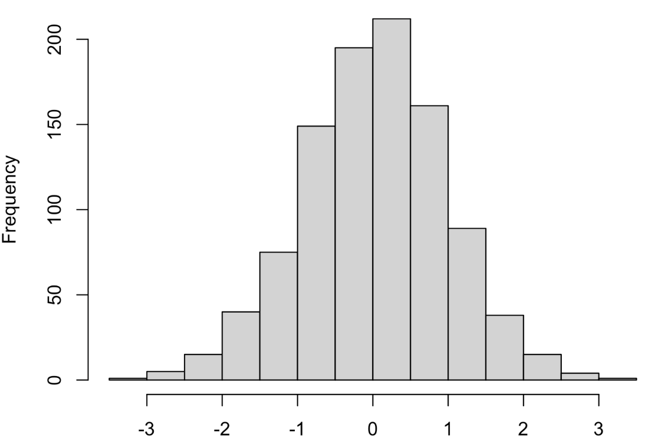
Your Turn 2
What is the name of this kind of plot?
Notes:
So what I’ve asked you to imagine is a plot in which we have the count or the frequency of a test on the y axis, and that’s broken down along the pandemic day over the x axis. Anybody know the name of that type of plot that has the count of a thing on the y axis and the distribution of those counts along the x axis?
Go ahead and type into the chat!

Slide 7
Your Turn 3
Type the following code into the “Creating a ggplot section” code chunk and execute in the markdown to make a graph.
Pay attention to the spelling, capitalization, and parentheses!
ggplot(data = k_data) +
geom_histogram(mapping = aes(x = value))
Does the plot fit the image you were expecting? Why or why not?
Stop when it says “Stop Here”. Put up your sticky.
Notes:
So let’s build the histogram of covid tests by pan_day! What I’m going to ask you now is to go to your RStudio console, not the editor but the console, and type in the code starting with “ggplot” exactly as it’s written here. Let me know that you’re done by clicking “yes”!
(Show people the console)

Slide 8
using `bins = 30`. Pick better value with `binwidth`.
Often times, things that look like an error in R are actually just a message.
R lets you know that when you ask it to draw a histogram you should tell it how wide each bin should be, because this affects the granularity of the data displayed.
ggplot(data = k_data) +
geom_histogram(mapping = aes(x = value))
Notes:
**Delete from PDF deck**
Is this what you get? Great.
- Actually, you might have gotten this message here in firetruck red.
- And often times, …
This is a useful message, and we will later on look at how to do that.

Slide 9
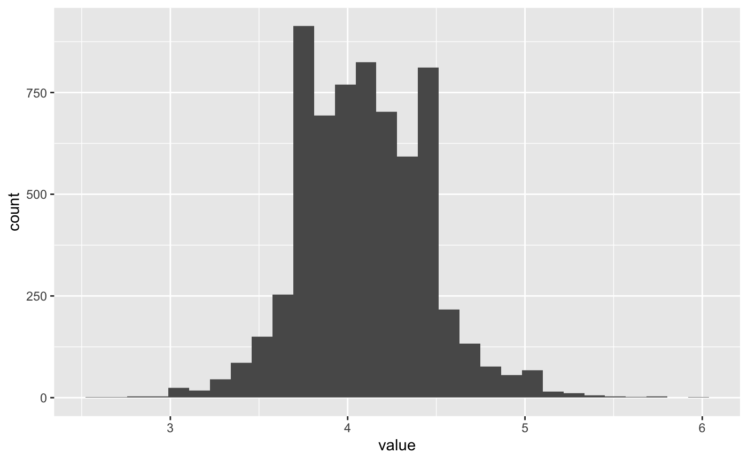
ggplot(data = k_data) +
geom_histogram(mapping = aes(x = value))
9
Notes:
**Delete from PDF deck**
When I asked you to imagine what this plot might look like - the number of COVID tests that were performed on a given day over time – you might have imagined something like this. Initially you have very few tests that are being run, maybe because the pandemic hasn’t really started yet and maybe also because the test isn’t yet broadly available. And at some point the number of tests shoots up and remains at a high level. But this simple visualization tells you so much more than that general shape. You can see that by 30 days, the testing ramp-up settles. And it tells you a few things you might not have expected and that may make you want to look at – like, there’s something going on with testing volume fluctuating after day 60.
None of this would be apparent from looking at a table with 15,000 rows.
So the point of this exercise is to realize that you might have some ideas about your data, but usually they are incomplete and often times they are just plain wrong. If you don’t visualize the data you’re probably missing important information. That's why in data science, people say that visualization is one of the two main engines of knowledge generation (the other one is modeling). Being able to visualize data quickly is a critical skill for efficient data analysis.

Slide 10
Notes:
We’ll be using the ggplot2 package for creating graphics. ggplot2 is part of the tidyverse so it will get loaded when you load the “tidyverse” package.
GGplot provides a "grammar of graphics" for data visualization. The idea of having a “grammar” for something is actually pretty common in R and we’ll revisit this in the session on data transformation. Essentially, there should be a consistent way to build a any type of graph. This makes it easier to learn and also easier to for humans to read the code later and make sense of it. And that’s super important because most people who use R are not professional programmers.
The idea of the grammar of graphics is that you should be able to specify any type of graph by specifying the data that goes into it, a the type of graph that you want to make, and a mapping that describes how the data should be represented as visual marks on that graph.
Having a consistent grammar means that once you learn how to make a histogram that knowledge can be applied to make a scatter plot with little extra effort. This makes it easy to generate lots of different graphs quickly which helps you understand your data more quickly.
Also, ggplot2 graphs look great and you can definitely use ggplots for publications.

Slide 11
ggplot()
Always start with ggplot()
+ sign
before new line
data frame
ggplot(data = k_data) +
geom_histogram(mapping = aes(x = value))
mappings inside
aes() function
type of plot
x axis
mapping
Notes:
So here a quick analysis of how we just used ggplot to make that histogram.
You can see that we give it a ** data frame, in this case, our covid_testing data
We specify the ** type of plot, or “geom”, in this case, a histogram
And we specify an ** aesthetic mapping. In this case, we’re saying that we want the x axis to represent the pan_day. Since this is a histogram, I don’t have to specify the y axis, because in a histogram the y axis is always the count of cases in a bin.
A few more details to note: you always start a plot by calling the ** ggplot() function;
To connect the ggplot function to the geom function you use a ** ‘+’ sign which you usually put at the end of the line, followed by a newline;
and the mappings need to go inside the ** aes() function. “AES” is for “aesthetic mapping”.

Slide 12
To make any kind of graph:
1. Pick a “tidy”
data frame
ggplot(data = data_frame) +
geom_function(mapping = aes(mappings))
2. Pick a “geom” function
3. Write aesthetic mappings
Notes:
So that was a lot of information. Let’s break this down to build up to a more general template. Here’s a preview of that template, and we’ll spend the next 15 minutes or so exploring it.
You start with the code written in black – black is constant part - and fill in the details written in blue. To fill in the details, you need to do 3 things: ** Pick a tidy data frame (this contains the data you want to plot),
** Pick a geom function (this is the type of plot you want to make), and
** Write aesthetic mappings (and we’ll go over what that means)

Slide 13
1. Pick a “tidy”
data frame
ggplot(data = data_frame) +
geom_function(mapping = aes(mappings))
3. Write aesthetic mappings
Notes:
The first detail you need to define is a “tidy” data frame <- this contains the data you want to plot.

Slide 14
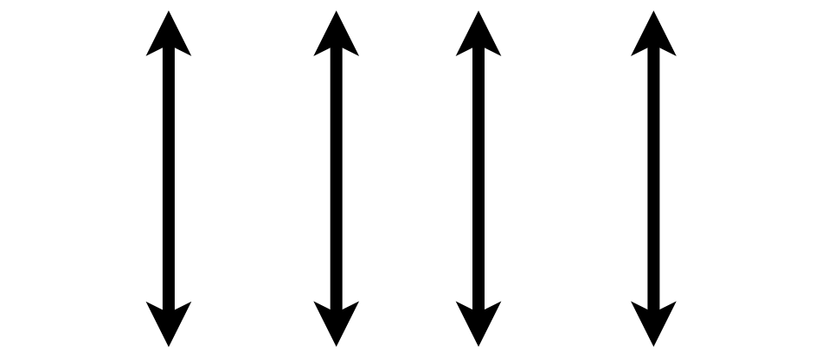
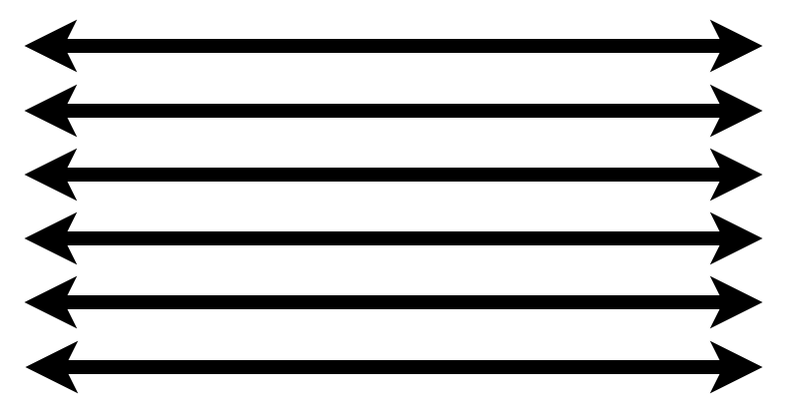
1. Pick a “Tidy” Data Frame
A data set is tidy if:
Each variable is in its own column
Each observation is in its own row
Each value is in its own cell
Wickham H. Tidy Data. J Stat Soft 2014.
Notes:
What do I mean by “tidy” data frame?
A data set can take on a lot of different shapes. But there is one shape that is best suited for data analysis, and that shape is called ”tidy.”
A data set is tidy if: ** each variable is in its own column;
** Each observation is in its own row, and
** Each value is in its own cell.
The opposite of “tidy” is often called “messy.” And often times much of the data analysis work is to convert “messy” data into “tidy data.” But for now, fortunately for us, the covid_testing data set is tidy already.
We’re going to revisit the concept of “tidy data” tomorrow.

Slide 15
1. Pick a “tidy”
data frame
ggplot(data = data_frame) +
geom_function(mapping = aes(mappings))
2. Pick a “geom” function
Notes:
The next step is to pick a geom function… this is how you tell R what kind of plot you want to create.

Slide 16
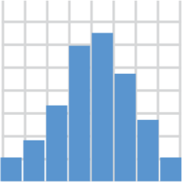
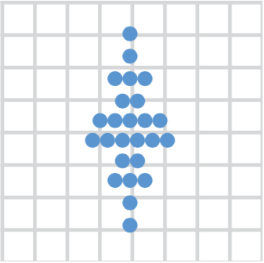
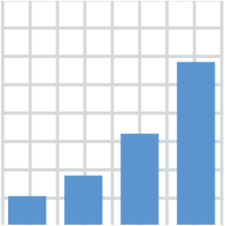
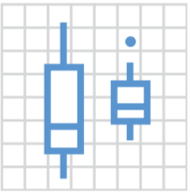
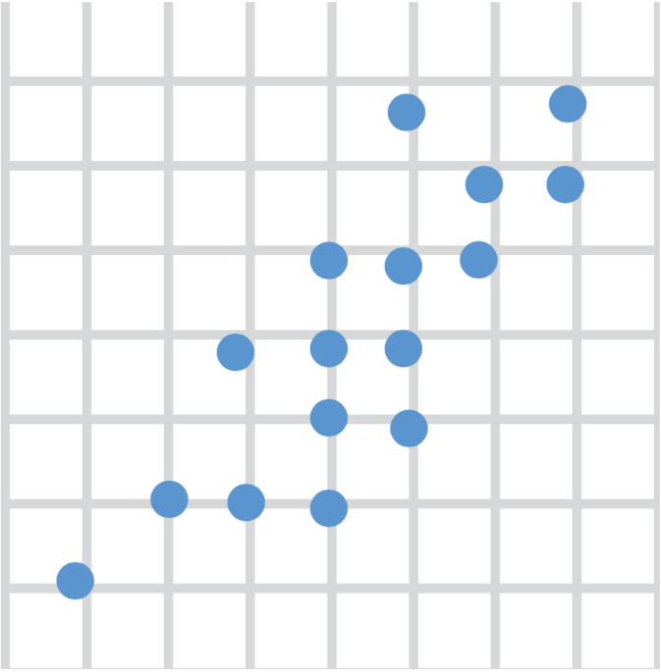
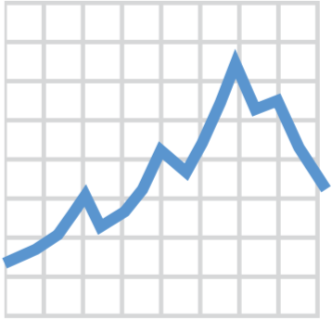
2. Pick a “Geom” Function
geom_histogram()
geom_dotplot()
geom_bar()
geom_boxplot()
geom_point()
geom_line()
Notes:
We’ll go into more detail about what geom functions are, but for now, just know that you need to tell ggplot what type of graph you want, and you do that by picking the right geom_ function.
Here are the six geom functions that I think are the most useful for visualizing clinical data. You can make histograms, bar graphs, scatter plots, dot plots, boxplots, and line graphs. There are many more geom functions available, but you are going to get a lot of mileage by just knowing about these ones here.

Slide 17
1. Pick a “tidy”
data frame
ggplot(data = data_frame) +
geom_function(mapping = aes(mappings))
2. Pick a “geom” function
3. Write aesthetic mappings
Notes:
The third and last step is to write “aesthetic mappings”. An aesthetic mapping relates the columns of a data frame to things like axes or colors on the plot.

Slide 18
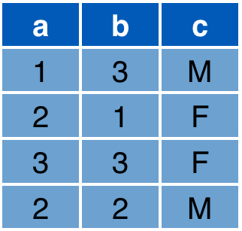

3. Write Aesthetic Mappings
aes(x = a, y = b, color = c)
Data frame
Graph
y
x
Notes:
So what's an aesthetic and what’s an aesthetic mapping?
An aesthetic is something that you can see about a data element on a graphic, such as its position on an x/y grid, but also other features such as for example its color.
An aesthetic mapping is a rule that tells ggplot how to draw the data from a specific column of the data set on the plot.
For example: consider this data frame with 3 columns: a, b, and c; and this x/y grid.
The aesthetic mapping above defines that the ** x axis position of each marking should be derived from the "a" column'
The ** y axis position from the "b" column
And that the ** color should come from the "c" column.
As a result, you get the following ** graph, which visually encodes all the information from those 3 columns in the data frame. (R automatically figures out reasonable axis limits and a color scale, but you can fine tune this manually.)

Slide 19
Aesthetics
From Fundamentals of Data Visualization, by Claus Wilke, licensed under CC-BY-NC-ND
Notes:
y/x position and color are the most common aesthetics you will use. If you want to plot more than 3 variables at a time, you can also use shape or size, and for line graphs, you can use line width or line type such as solid or scattered as aesthetics.
One thing to notice is that things like axis labels, labels, fonts, and annotations aren’t considered aesthetics. This is because they don’t have a relationship with each individual data point in a data set. So when we talk about aesthetics we strictly talk about graphical features that encode specific features of a data point.
Picking the best aesthetics for your graph is as much an art as it is a science. At the end of this session, I’ll have a recommendation for a reference that is a great introduction to this topic if you’re interested.

Slide 20
To make any kind of graph:
1. Choose a “tidy”
data frame
ggplot(data = data_frame) +
geom_function(mapping = aes(mappings))
2. Pick a “geom” function
3. Write aesthetic mappings
Notes:
So let’s recap. To make any kind of graph, you start with the template and…
** Pick a tidy data frame (this contains the data you want to plot),
** Pick a geom function (this is the type of plot you want to create), and
** Write aesthetic mappings (this is where you map data elements to x/y position, color, and possibly other graphical features)

Slide 21
Your Turn 4
Go back to 03 - Visualize.qmd. Work through the exercises of the section titled “The ggplot Template and Aesthetics”. Stop when it says “Stop Here”.
Put up your sticky.
Notes:
7 min

Slide 22
Setting vs Mapping Aesthetics
Notes:
Let’s spend the next few minutes on an important conceptual distinction about how you can define aesthetics in your plot.

Slide 23
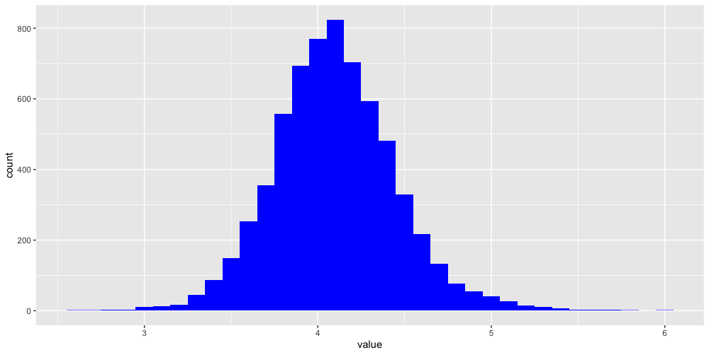
How would you make this plot?
Notes:
Consider this plot. It’s the same as the one you’ve created at the beginning of the session, except the bars are blue, not black. So the difference is the “fill” aesthetic. But we’re not really mapping the fill aesthetic to a variable here, because all bars are the same fill color. They don’t represent the values of a variable of a data frame. Instead, we’re setting it to a constant value, the color blue. Let’s look at how you can do this with ggplot.

Slide 24
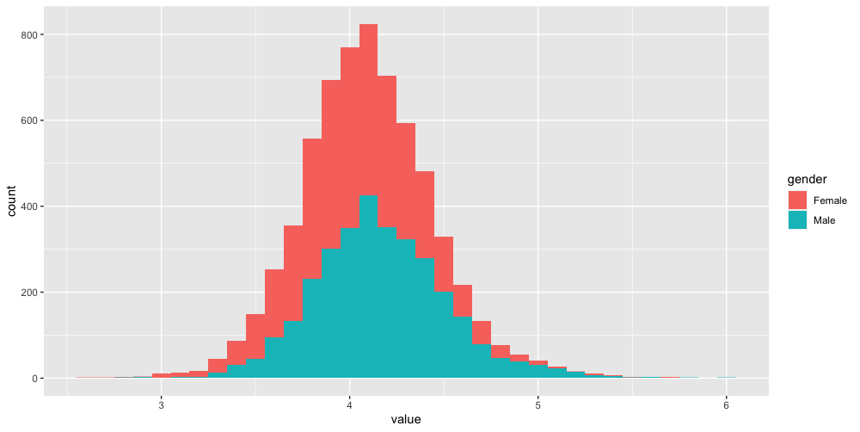
Inside of aes():
map an aesthetic to a variable
ggplot(data = k_data) +
geom_histogram(mapping = aes(x = value, fill = gender))
Notes:
In the exercise, you just mapped the “fill” aesthetic to the “result” variable, by writing ”fill = result” inside the aes function.
The general rule is: if an aesthetic is defined inside of the aes function then that aesthetic gets mapped to a variable (or column).

Slide 25
Outside of aes():
set an aesthetic to a value
color name in “quotes”
ggplot(data = covid_testing) +
geom_histogram(mapping = aes(x = pan_day), fill = "blue")
Notes:
If the aesthetic is defined outside of the aes function (but still inside of the geom function) – then it’s set to a constant value, like “blue”. R knows a lot of different colors by their English name.
** Color names need to be put into quotes.

Slide 26
ggplot(data = covid_testing) +
geom_histogram(mapping = aes(x = pan_day, fill = result))
ggplot(data = covid_testing) +
geom_histogram(mapping = aes(x = pan_day), fill = "blue")
Notes:
To recap setting vs mapping aesthetics:
If you define an aesthetic inside aes() -> aesthetic gets mapped to a variable of the data frame
If you define an aesthetic outside aes() -> aesthetic gets set to constant value

Slide 27
Geom Functions
Notes:
We’ve briefly looked at geom_ functions earlier and you might now appreciate how that makes it so easy to switch out one type of graph for another. But let’s dive a bit deeper into the concept of geom functions.

Slide 28
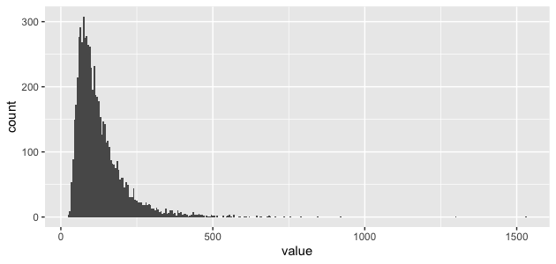
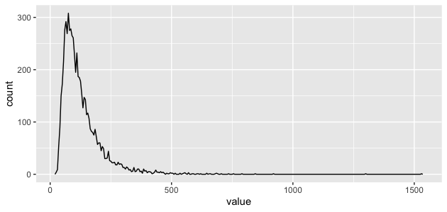
How are these plots similar?
Same: x axis, y axis, data
Notes:
Consider these two plots. How are they similar?
* The x axis is the same, pan_day,
* and the y axis as well, count.
* Actually, the underlying data is the same as well.

Slide 29
How are these plots different?
Different geometric object (“geom”) used to represent the data
Notes:
What’s different is that on the left, the data is shown as a histogram, and on the right, it’s shown as what’s called a frequency polygon.
* So a geom function is a function that, given the data, and aesthetic mappings, generates the graph, or in ggplot jargon, the geometric object used to represent the data, hence the term “geom” function.

Slide 30
Your Turn 5
Return to 03-Visualize.qmd. Work through the exercises of the section titled “Geom Functions.”
Stop when it says “Stop Here”.
Put up your sticky.
Notes:
** Breakouts (about 5 min) **

Slide 31
Faceting
Notes:
We’ve briefly looked at geom_ functions earlier and you might now appreciate how that makes it so easy to switch out one type of graph for another. But let’s dive a bit deeper into the concept of geom functions.

Slide 32
Features can be added as “layers” to the plot
ggplot(data = data_frame) +
geom_function(mapping = aes(mappings)) +
facet_function +
theme_function +
scale_function +
coordinate_function +
...
Required
Optional
Notes:
All of these elements, like position adjustments, themes, color scales, facets, coordinate systems, and text can be added to a ggplot command in the same way that we added a second geom layer – by writing a plus sign followed by a theme function, a scale function, a facet function, etc. You can find out about these functions on the Data Visualization Cheat Sheet.

Slide 33
Facet functions create subplots of a data frame based on one or more variables
ggplot(data = data_frame) +
geom_function(mapping = aes(mappings)) +
facet_grid(rows = vars(variable), …)
Create subplots based on variable
Can alter scales or labels
Notes:
So let’s recap. To make any kind of graph, you start with the template and…
** Pick a tidy data frame (this contains the data you want to plot),
** Pick a geom function (this is the type of plot you want to create), and
** Write aesthetic mappings (this is where you map data elements to x/y position, color, and possibly other graphical features)

Slide 34
A grid of subplots can be created based on two variables
ggplot(data = k_data) +
geom_histogram(mapping = aes(x = value)) +
facet_grid(rows = vars(gender),
cols = vars(pat_type),
scales = “free”)
Notes:
So let’s recap. To make any kind of graph, you start with the template and…
** Pick a tidy data frame (this contains the data you want to plot),
** Pick a geom function (this is the type of plot you want to create), and
** Write aesthetic mappings (this is where you map data elements to x/y position, color, and possibly other graphical features)

Slide 35
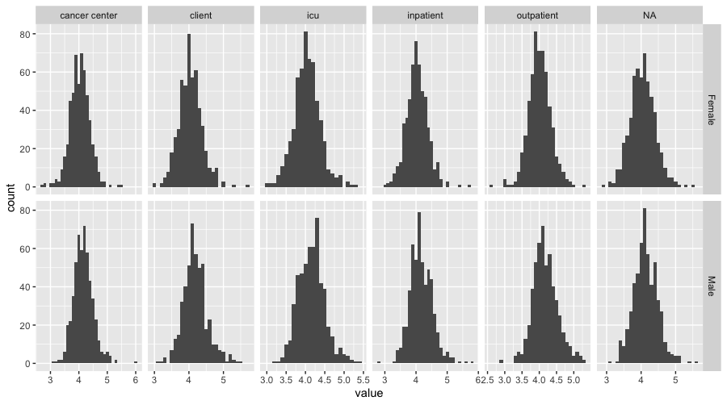
ggplot(data = k_data) +
geom_histogram(mapping = aes(x = value)) +
facet_grid(rows = vars(gender),
cols = vars(pat_type),
scales = “free”)

Slide 36
Your Turn 6
Return to 03-Visualize.qmd. Work through the exercises of the section titled “Faceting.”
Stop when it says “Stop Here”.
Put up your sticky.
Notes:
** Breakouts (about 5 min) **

Slide 37
Asking AI for Help
Notes:
We’ve briefly looked at geom_ functions earlier and you might now appreciate how that makes it so easy to switch out one type of graph for another. But let’s dive a bit deeper into the concept of geom functions.

Slide 38
Large language models can help you write code
Large language models have been trained with large volumes of information available on the public internet
Includes defined questions and code written to answer questions from websites such as Stack Overflow
The wisdom of the internet is generally pretty good…
for coding, at least

Slide 39
LLMs work better if you “speak the language”
Consider 2 prompts:
Give me some R code to plot a comparison of potassium values between inpatients and outpatients
Vs.
I have a dataframe called “k_data” that includes potassium test values in a variable called “value” and information on the setting in which the patient’s orders were placed in a variable called “pat_type”, which includes inpatient and outpatient testing. Can you provide R code to produce faceted plots that compare the distributions of values across the different pat_type categories?

Slide 40
Tips for success with LLM help
Provide clear descriptions of the data set (dataframe) you are working with, using tidy data terms (e.g. observations, variables, values)
Always try to break down your problem into multiple discrete steps and iteratively prompt for each step, then review the output at each step. This will help you assess whether the LLM output is correct and allows you to immediately provide feedback on a discrete step.
Lots of code on the internet uses “base” R that often doesn’t align to tidy data assumptions and may be harder for you to understand. You can be explicit in asking for solutions that use “tidyverse” packages and functions.

Slide 41
Your Turn 7
Homework: Return to 03-Visualize.qmd. Work through the exercises of the section titled “Asking AI for Help.”
We will review solutions at the start of the next lesson.

Slide 42
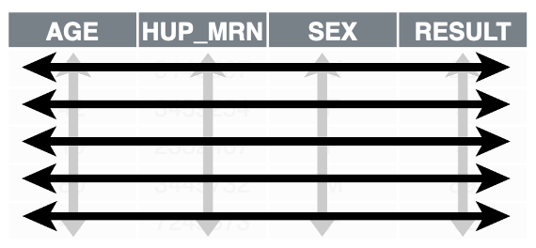
Recap
ggplot2 is a package that provides a grammar of graphics. You can create any type of plot using a simple template to which you provide:
1. A tidy data frame, in which each variable is in its own column, each observation is in its own row, each value is in its own cell;
2. A geom function, which tells R what kind of plot to make; and
3. Aesthetic mappings, which tell R how to represent data as graphical markings on the plot.
Aesthetics can be mapped to a variable or set to a constant value.
Notes:
To recap:
…

Slide 43
What Else?
Notes:
In this last part of this session, I want to show a few additional things you can do with ggplot, without going into much detail.

Slide 44
ggplot(data = data_frame) +
geom_function(mapping = aes(mappings)) +
theme_function +
scale_function +
facet_function +
coordinate_function +
...
Required
Optional
Notes:
All of these elements, like position adjustments, themes, color scales, facets, coordinate systems, and text can be added to a ggplot command in the same way that we added a second geom layer – by writing a plus sign followed by a theme function, a scale function, a facet function, etc. You can find out about these functions on the Data Visualization Cheat Sheet.

Slide 45
Position adjustments
How overlapping objects are arranged
Notes:
We’ve only scratched the surface of what you can do with ggplots, especially when you combine them with data wrangling tools that you’ll learn about tomorrow. For example, you can change how overlapping objects are arranged, for example from a stacked histogram to side-by-side bars.
ggplot(covid_testing) +
geom_histogram(
mapping = aes(x = pan_day, fill = result),
position = position_dodge()
)

Slide 46
Themes
Visual appearance of non-data elements
Notes:
You can use different themes which affect how non-data elements such as axes, gridlines, and background appear.
ggplot(covid_testing) +
geom_histogram(
mapping = aes(x = pan_day, fill = result),
position = position_dodge()
) +
theme_light()

Slide 47
Scales
Customize color scales and other mappings
Notes:
You can customize color scales.
library(colorspace)
cols <- c(
"invalid" = "grey80",
qualitative_hcl(2, palette = "dark3")
)
ggplot(covid_testing) +
geom_histogram(
mapping = aes(x = pan_day, fill = result),
position = position_dodge()
) +
theme_light() +
scale_fill_manual(values = cols)

Slide 48
Coordinate systems
Notes:
You can make radial plots or geographical maps.
ggplot(covid_testing) +
geom_histogram(
mapping = aes(x = pan_day, fill = result)
) +
theme_light() +
scale_fill_manual(values = cols) +
facet_wrap(~demo_group) +
coord_polar()

Slide 49
Titles and captions
Notes:
An you can add titles, subtitles, or annotations, and change the axis labels or the appearance.
ggplot(covid_testing) +
geom_histogram(
mapping = aes(x = pan_day, fill = result)
) +
theme_light() +
scale_fill_manual(values = cols) +
facet_wrap(~demo_group) +
coord_polar() +
ggtitle(
label = "COVID19 test volume",
subtitle = "Displayed in polar coordinates, mostly to show off ggplot2"
)

Slide 50
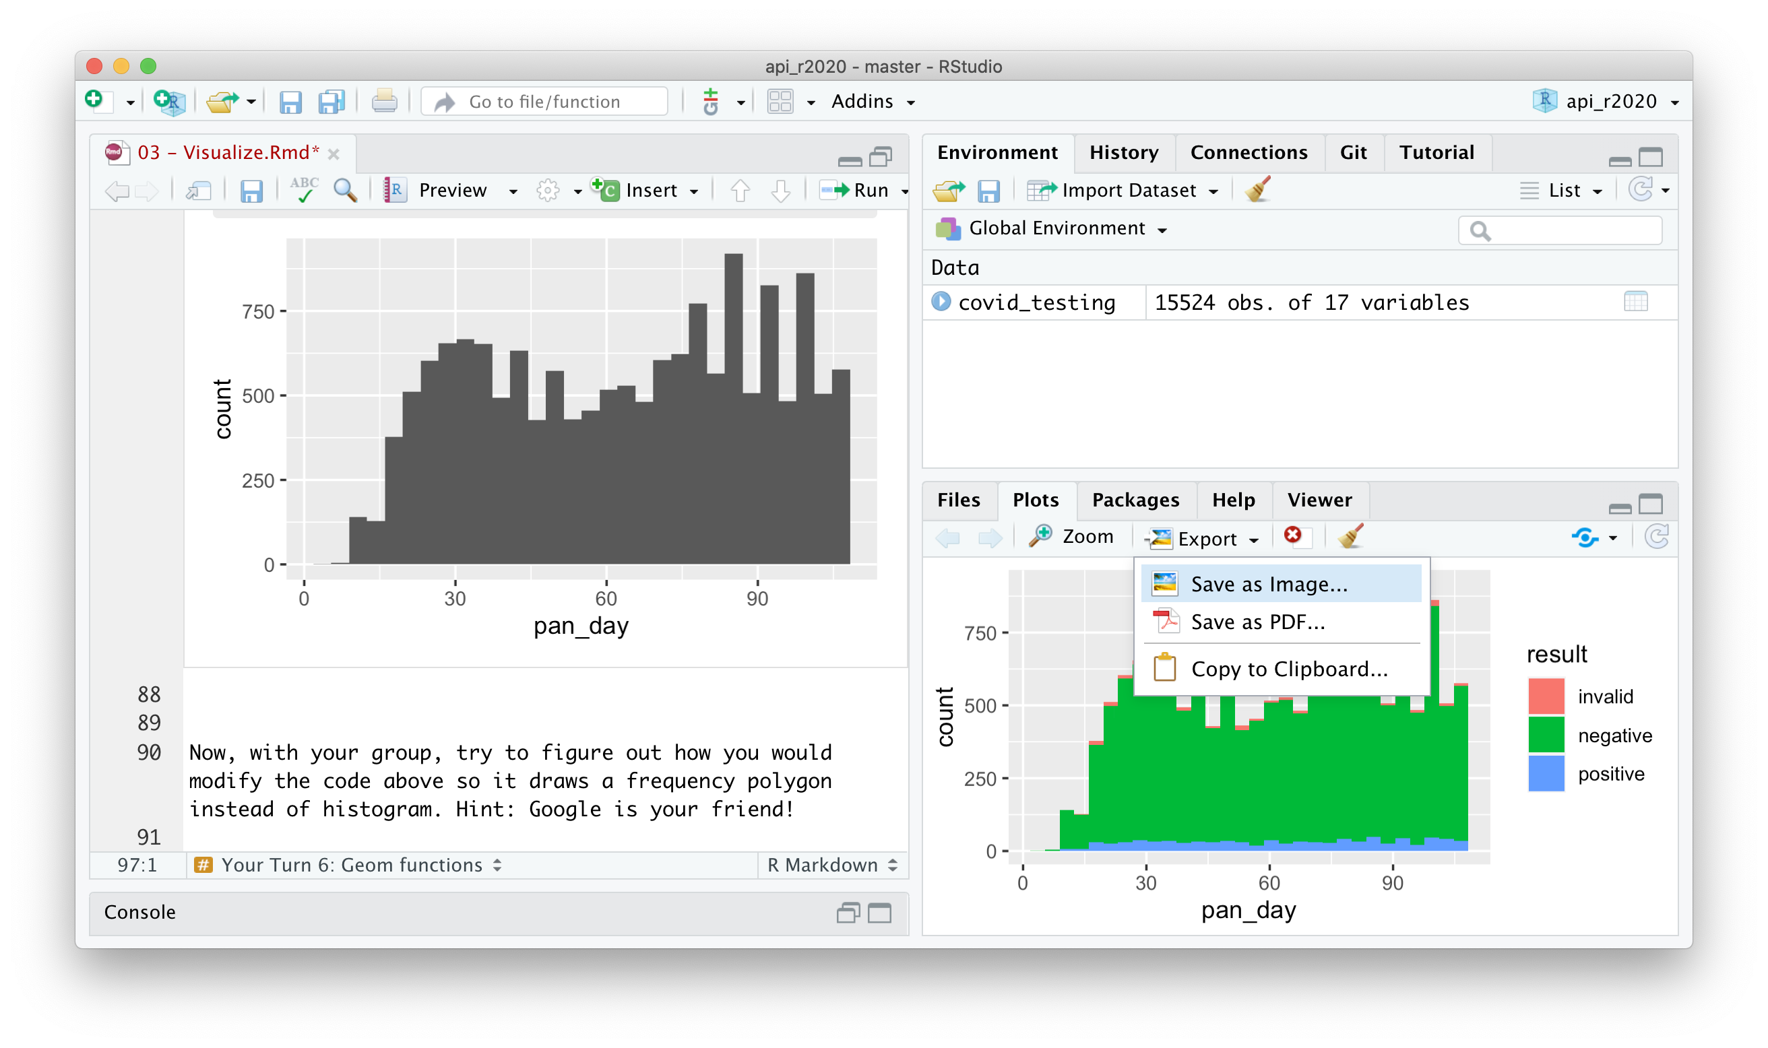
Manually saving plots
Plots > Export > Save as Image…
Right Click >
Save Image As…
Notes:
To save a plot you’ve created in the console, you can go to the Plots pane on the bottom right of the RStudio window, click export, and select Save as Image.
- To save a plot you’ve created by running some code inside an R notebook, you can right-click and select “Save image as”

Slide 51
ggsave( ) is the most comprehensive method to save plots
ggsave(filename,
plot = last_plot(),
device = NULL,
path = NULL,
scale = 1,
width = NA,
height = NA,
units = c("in", "cm", "mm", "px"),
dpi = 300, ... )

Slide 52
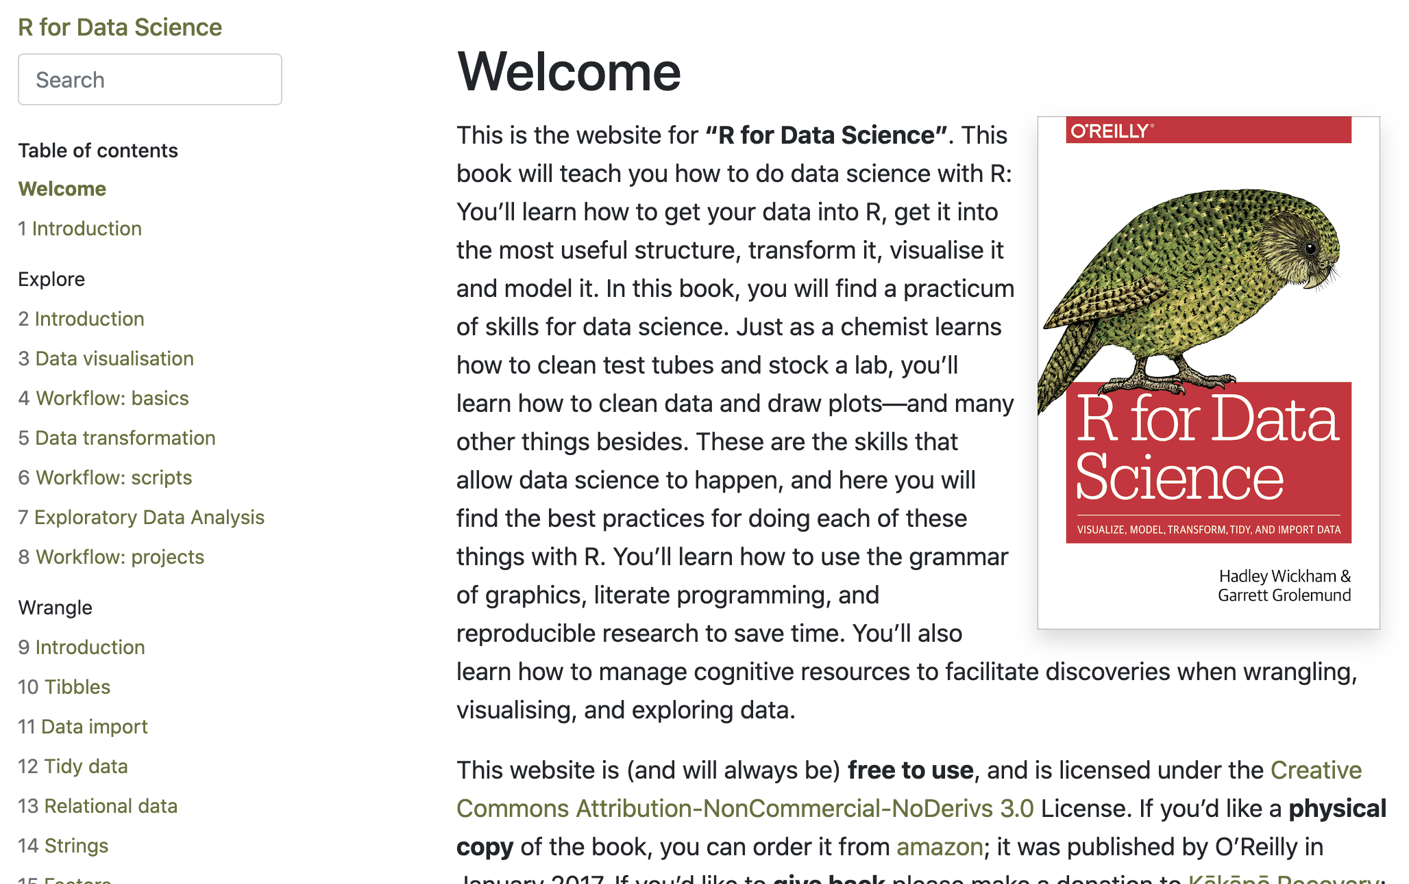

https://r4ds.had.co.nz/
Notes:
If there is one resource that I would recommend above all else to continue learning about ggplot, the tidyverse, and data analysis in general, it’s the R for Data Science book by Hadley Wickham and Garrett Grolemund. This book is available for free at the website linked above, it’s very readable and has tons of exercises. A solutions manual is available online for free as well.

Slide 53
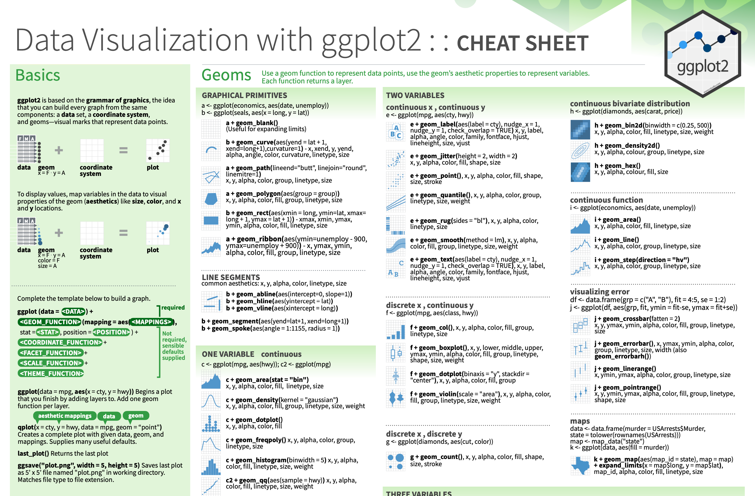
https://www.rstudio.com/resources/cheatsheets/
Notes:
The Data Visualization Cheat Sheet which is linked above is great to have on hand as you’re exploring your data with ggplot.
Right here on the left side it reviews the basic template for building any plot, which I went over. And in the main section, it covers the most useful geom functions.

Slide 54
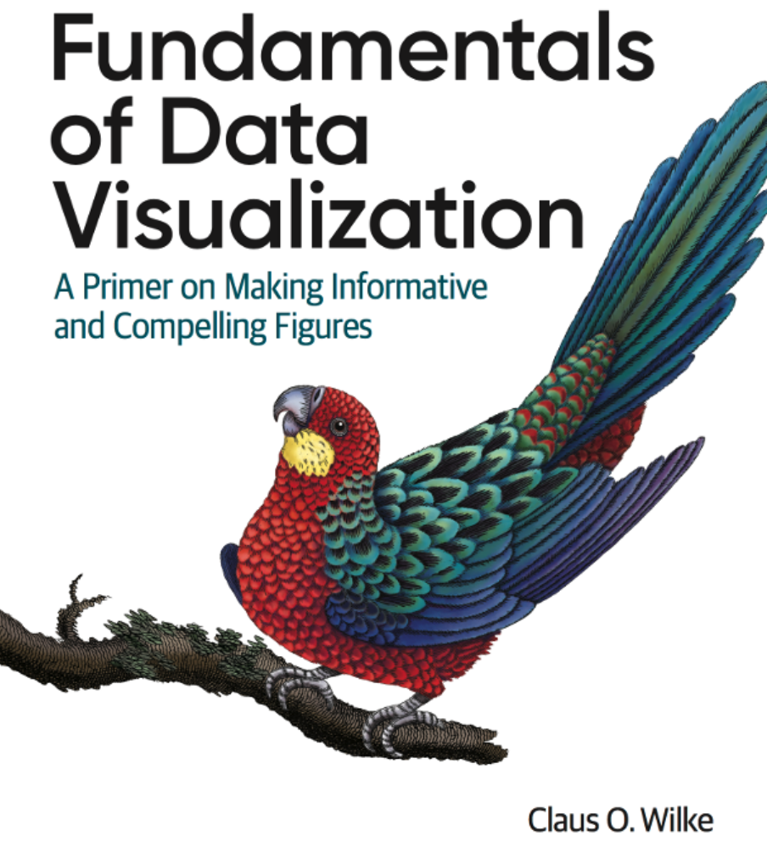
https://clauswilke.com/dataviz/
Notes:
If you’d like to learn more about which graphics are most effective in specific situations, I highly recommend taking a look at this free online ebook, Fundamentals of Data Visualizations by Claus Wilke.

Slide 55
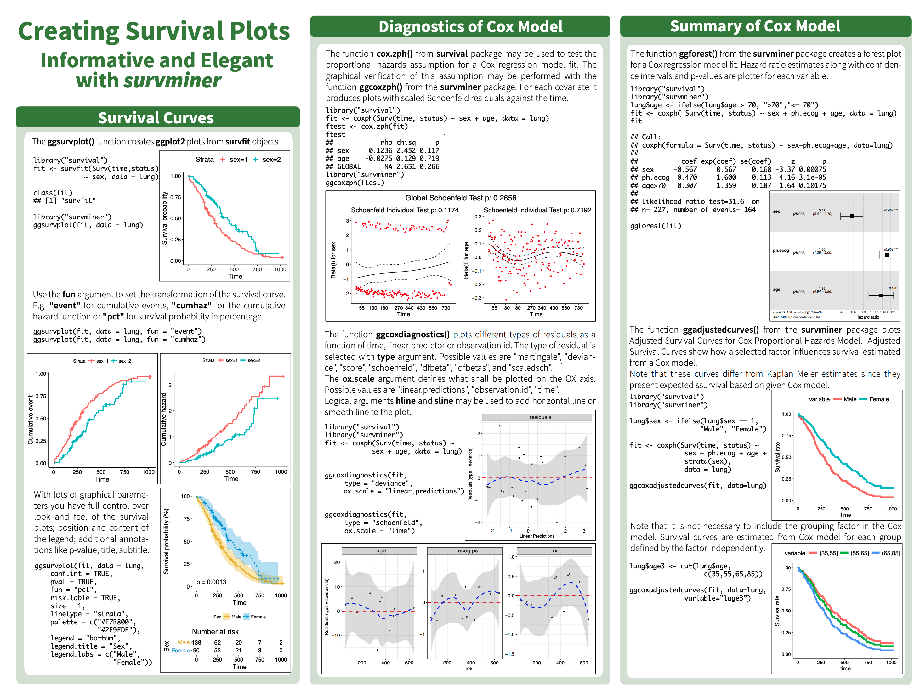
Notes:
The survminer package extends ggplot to make it straightforward to create publication-quality survival curves and risk tables.

Slide 56
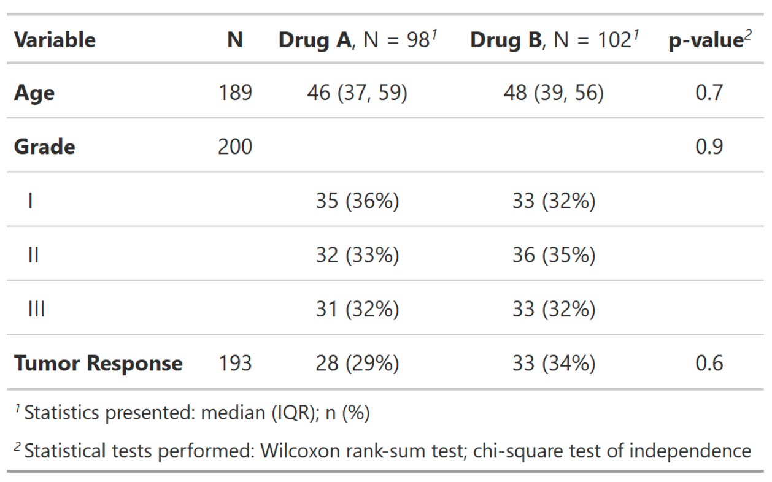
A grammar for tables
Notes:
The gt package provides a grammar create display tables, i.e. tables that you might want to show in a publication or on a summary report. The gtsummary package is very handy to generate publication-ready tables from a tidy data frame.

Slide 57
Lesson Goals
Create basic/static visualizations that elucidate relationships within datasets (e.g., histograms, scatterplots, time series, boxplots)
Utilize programming and software tools to facilitate efficient, reproducible, and transparent data analytics workflows
Lesson Objectives
Create a basic visualization using a simple template
Define “aesthetic mapping” and explain how aesthetic mappings relate variables of a data frame to features of graphic markings on a plot
Write the code to specify a type of plot and fine tune its appearance using “geom” functions
Explain how to add layers to a ggplot object to create complex and highly customized visualizations

